Slide 1
Running R in parallel — principles and practice
Bratislava 2018-04-23

Slide 2
"My R code is slow..."
Sometimes running an analysis script in R takes longer than you would like
Adding more computing power in the form of running R in parallel is something to consider
It is not difficult but also not entirely trivial

Slide 3
Questions for you
Have you been in a situation where your code took "too long" to run?
Have you in fact used some parallel solution with R?

Slide 4
Principles

Slide 5
Things to think about before anything else
You should seek to have an understanding which part of your code is the time consuming one, and why, and how
the function system.time() can help
understanding the details of the method you are using helps
knowing how to run a smaller version of the problem helps a lot
understanding even the basics of time complexity helps
Always be suspicious of for-loops!
Having more memory almost never helps

Slide 6
Code example
# simple example on the use of system.time
# and what difference a small change makes
N <- 1e6
x <- runif(N)
# squaring the elements
# the R way: whole object at a time
system.time(y <- x^2)
# for loop, with initialized object
y <- x # same length, values don't matter
system.time(
for(i in seq_along(x)) y[i] <- x[i]^2
)
# for loop with copying
y <- numeric(0) # 0-length vector, no content at all
system.time(
for(i in seq_along(x)) y <- c(y,x[i]^2)
)

Slide 7
Questions for you
If squaring the elements of a vector of length 100 takes 1 second, how long does it take to square the elements of a vector of length 200?
If squaring the elements of a square matrix of dimension 100 takes 1 second, how long does it take to square the elements of a matrix of dimension 200?

Slide 8
Real world example
20 observation sites, 4 observation times, 65 bird species
in the raw data zero frequencies are implicitly missing (not there at all)
we want them to be explicitly missing (zeros mentioned)
for (s in sites) for (t in times) for (b in birds) if seen then... else... ???
THIS WILL TAKE ABSOLUTELY FOREVER
it's a standard task, there's a smart way: tidyr::complete

Slide 9
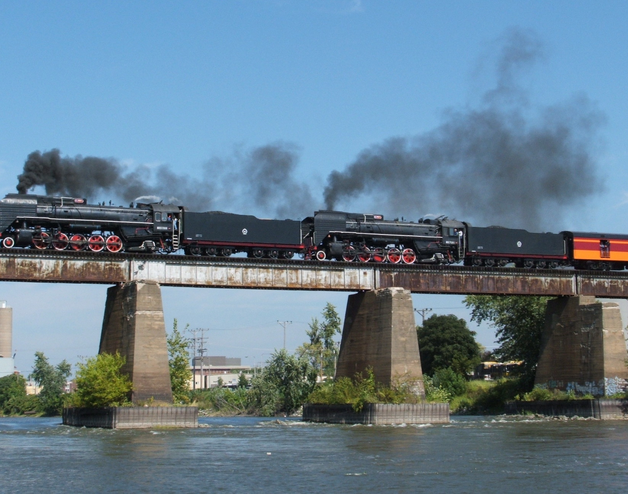
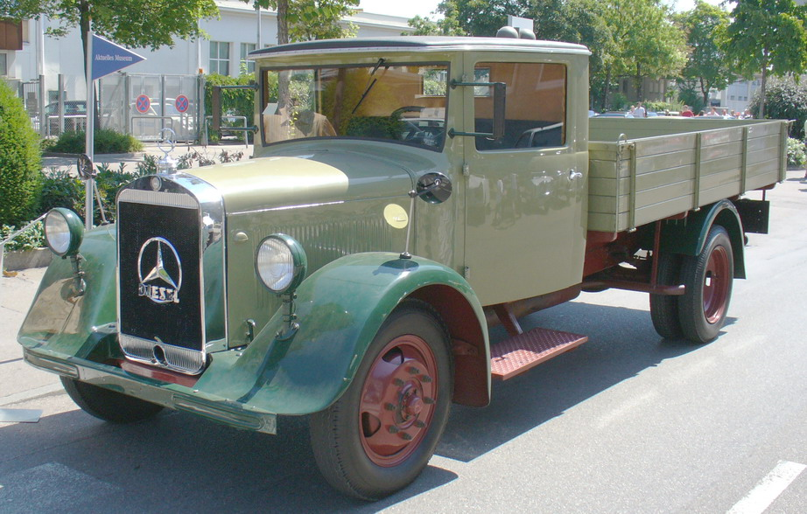
Mere presence of more cores does nothing
Note on vocabulary: processor, CPU, core, chip and node may or may not mean same or different things
With respect to workload cores are not like locomotives but more like trucks: several cores can not work on the exact same task
Simply taking your ordinary R and R code to a laptop with 8 instead of 1 otherwise similar cores gives no speed boost at all.
Somebody (possibly you) has to do something to divide the workload
By Douglas W. Jones - Own work, Public Domain,
https://commons.wikimedia.org/w/index.php?curid=7756596
CC BY-SA 3.0,
https://commons.wikimedia.org/w/index.php?curid=228396

Slide 10
Parallel scaling
Unfortunately, increasing the number of cores will never decrease the time needed in the same proportion
Not all parts of the program will benefit from parallel computing (Amdahl's law)
Parallel computing introduces extra work that wouldn't need to be done when computing serially (overhead)
Due to these facts increasing the number of cores may help only up to a point but no further, or even not at all, and it may depend on many things such as data size

Slide 11
Practice

Slide 12
Level zero: not even parallel, just simultaneous
Can you imagine going around in a computer classroom, firing up R on every computer and letting each one work on part of your problem?
such as each fitting the same model to 20 different data sets or with 20 different combinations of parameters
Do you also have access to a cluster with R installed on it? Good! Then you can do the same without even getting up from your chair. This is an array job.
Upside: really easy. Downside: limited usability, probably cumbersome even with some automation

Slide 13
Your own laptop vs. a remote cluster
The cores on your own laptop or desktop computer are (presumably) yours to use when ever and how you please
A big cluster or supercomputer (such as CSC's Taito and Sisu) may have thousands of users and at any given time its resources are at least partially in use by someone else
For these cases, different kind of resource allocation and batch job systems exist which add an extra layer of things to know about
Contact your local admins for help (and give them love and cookies)

Slide 14
Questions for you
Do you have access to a cluster like that?
Do you know about the "extra layer of things to know" there?
Have you done something like this before, or can you see it being relevant to you?

Slide 15
Intel MKL and Microsoft (Revolution) R
Wikipedia: "Intel Math Kernel Library (Intel MKL) is a library of optimized math routines for science, engineering, and financial applications."
"Microsoft R Open, formerly known as Revolution R Open (RRO), is the enhanced distribution of R from Microsoft Corporation. --- Compared to open source R, the MKL offers significant performance gains, particularly on Windows."
MS R Open is very easy to use - no changes in R code at all - it does give you a speedboost but only for certain operations (mainly matrix things).
and it only does that via Intel MKL and there are other ways to get that.

Slide 16
But how does one use Intel MKL?
You don't. R does:
You ask R to perform a matrix operation as usual
If R knows about an MKL installation it passes the task to it
MKL looks at the task, looks around at the cores it has available and decides whether to split up the operation in to chunks and how, and then puts the cores to work using threads
When the cores are done they report back to MKL, MKL reports back to R and R reports back to you

Slide 17
Code example
Simon Urbanek's R-benchmark-25.R at http://r.research.att.com/benchmarks/ with and without MKL

Slide 18
snow (parallel)
This R package offers support for simple parallel computing in R, following the master - workers paradigm
The snow cluster is initialized using one of the makeCluster() or getMPICluster() functions
The R programmer can then use functions such as ClusterCall() or ClusterApply() to run code on all of the cores in the cluster
that's either you or an author of another package
some functions accept a snow cluster handle as a parameter, others (attempt to) start the cluster on their own

Slide 19
Example: package BioPhysConnectoR
freq2p(i, aln, j2 = NULL, lett = NULL, cluster = NULL)
cluster: snow cluster object created with makeCluster()
"The computation of freq2p() is parallelized using parLapply() from the package snow."
This is the nice way: you, the end user, create the snow cluster object in a suitable way and give it to the function, which will then do its thing.

Slide 20
Example: package CePa
cepa.all.parallel(dif = NULL, bk = NULL, mat = NULL, label = NULL, pc, cen = default.centralities, cen.name = sapply(cen, function(x) ifelse(mode(x) == "name", deparse(x), x)), nlevel = "tvalue_abs", plevel = "mean", iter = 1000, ncores = 2)
ncores: number of cores for parallel computing
This is the unnice way: the package creates the snow cluster object for itself. If that doesn't work for you, there's nothing you can do about it.

Slide 21
foreach and doParallel
The foreach package provides an easy way to run for-loop structures in parallel
again, it is either you or the author of another package who gets to decide when and what gets divided
foreach uses one of several possible parallel backends which can be provided by snow (doParallel) or e.g. Rmpi (doMPI)
From the foreach vignette: "Running many tiny tasks in parallel will usually take more time to execute than running them sequentially"
so now you need to start paying attention to details

Slide 22
Code example
Several small examples using parallel foreach loops, with snow as the parallel backend
picked from the foreach vignettes

Slide 23
Details
See the CRAN Taskview on HPC
This is just a list of keywords that are related to all this!
"embarrassingly parallel"
Message passing interface (MPI) (R packages Rmpi and pbdMPI)
OpenMP (threads, shared memory)
GPU
chunking and load balancing
random number generation

Slide 24
Seija Sirkiä
PhD (statistics), senior application specialist & data scientist
seija.sirkia@csc.fi

